Slide 1
Project Title
CAPSTONE PROJECT
Presented By: PARTH VERMA
Faculty Name: Aman Shrivastava
College Name & Department: Haridwar University(B.Tech CSE(AI & ML))

Slide 2
OUTLINE
Problem Statement
Proposed System/Solution
System Development Approach
Algorithm & Deployment
Result (Output Image)
Conclusion
Future Scope
References

Slide 3
Problem Statement
Despite the expansion of the Tele-Law initiative across states and districts, there is limited understanding of demographic utilization patterns and regional disparities in legal aid access. The challenge is to analyze Tele-Law case registration data to uncover gender-wise, caste-wise, and geographic disparities in service utilization across CSCs. Uneven representation among marginalized groups (SC, ST, OBC) and low outreach in certain districts raise concerns about equity and effectiveness. Moreover, the varying number of CSCs per region complicates direct comparisons. This problem demands a data-driven approach to evaluate inclusivity and optimize service delivery.

Slide 4
Proposed Solution
The proposed system analyzes Tele-Law case registration data to identify demographic and regional disparities in access to legal aid services. Using data analytics, the system evaluates gender-wise, caste-wise (SC, ST, OBC), and district-wise utilization patterns to assess inclusivity.
District-level data from FY 2021–22 to 2024–25 is collected and preprocessed to handle missing values and inconsistencies. Case registrations are normalized based on the number of Common Service Centres (CSCs) to enable fair regional comparison.
Analytical techniques are applied to identify underrepresented communities and districts with low outreach. The system is developed and deployed using IBM Cloud Lite services, with data processing and visualization supported by IBM Watson Studio.
The outcome provides clear insights into Tele-Law service gaps, highlights underserved regions, and supports data-driven decision-making to improve inclusive legal access.

Slide 5
System Approach
The system uses district-wise Tele-Law data from FY 2021–22 to 2024–25. Data processing and analysis are performed using Python-based analytics tools. IBM Cloud Lite services are used for data storage, analysis, and deployment, with IBM Watson Studio supporting visualization and reporting.

Slide 6
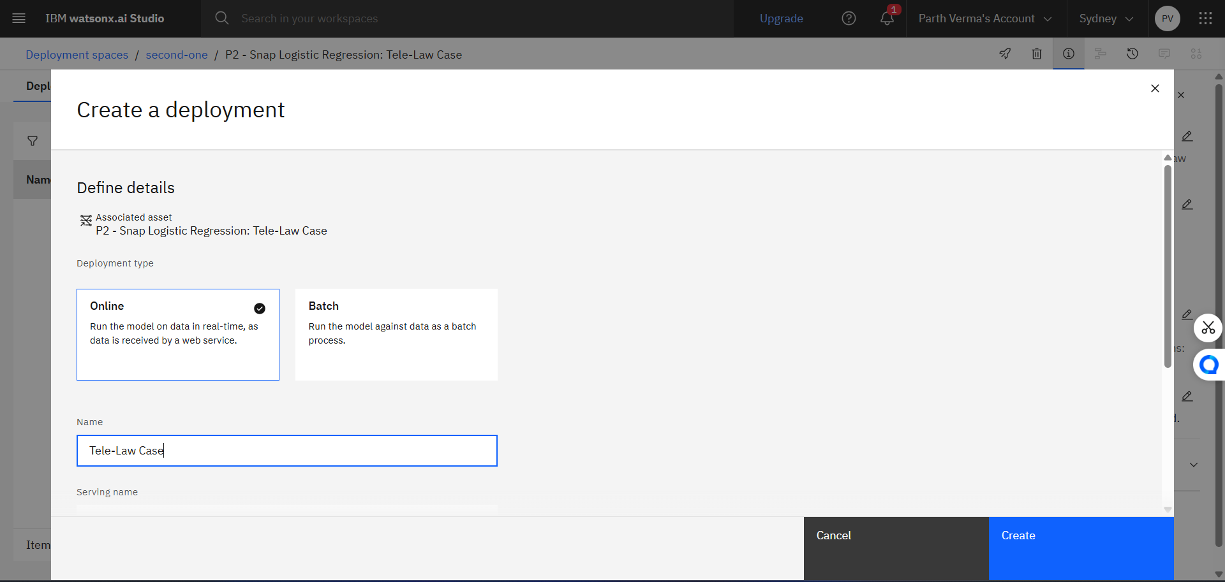
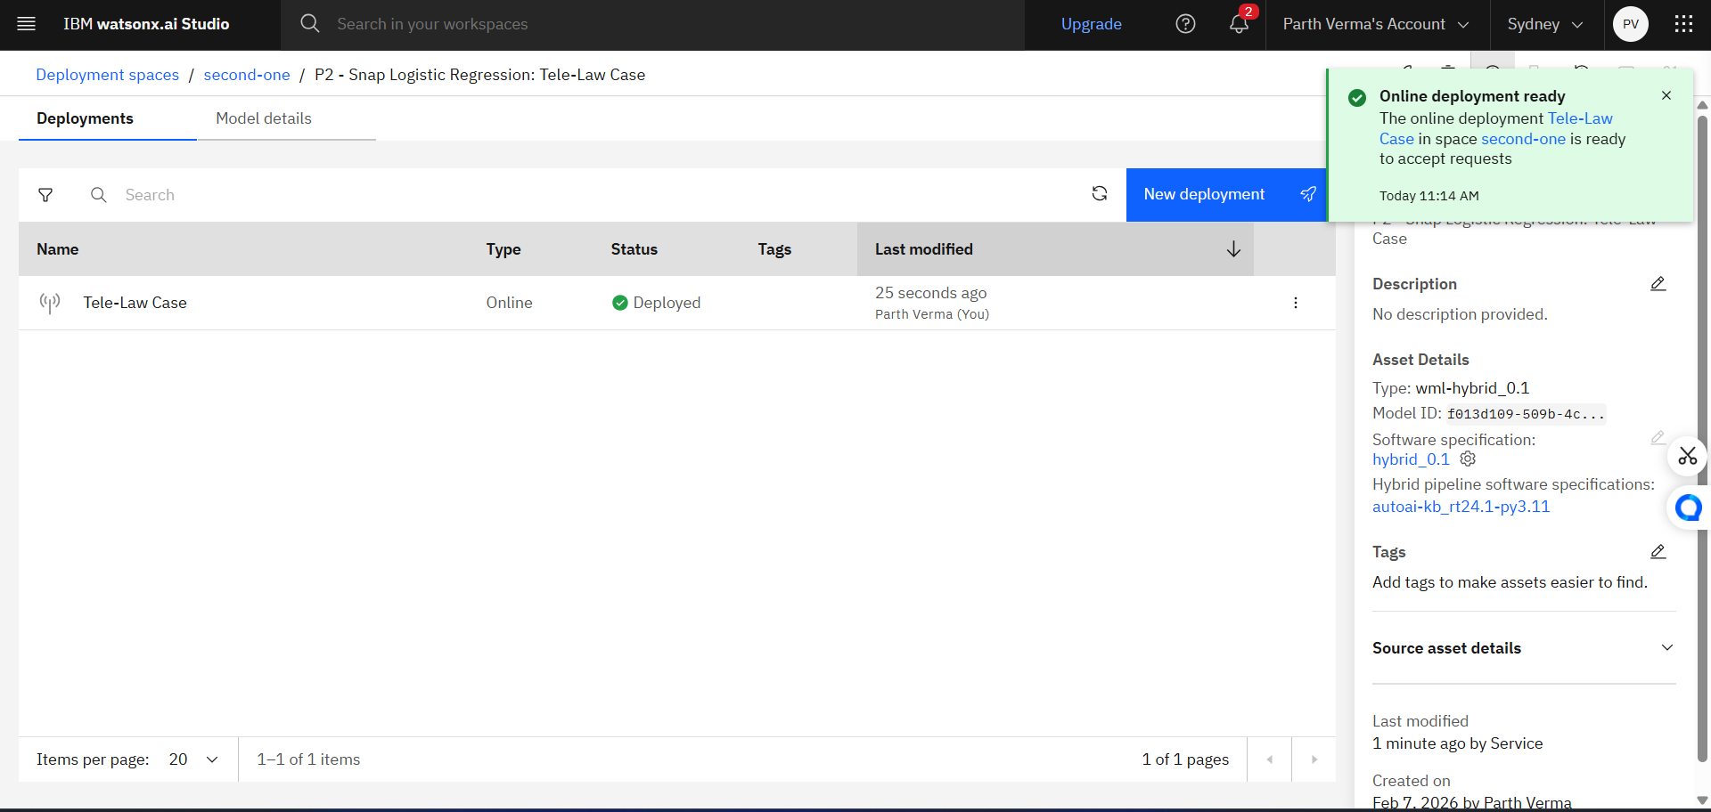
Algorithm & Deployment
The system applies descriptive and comparative statistical analysis to evaluate demographic and regional patterns. CSC-normalized metrics are used for fair comparison across districts. Analytical results and visual dashboards are deployed using IBM Cloud Lite for accessibility and scalability.

Slide 7
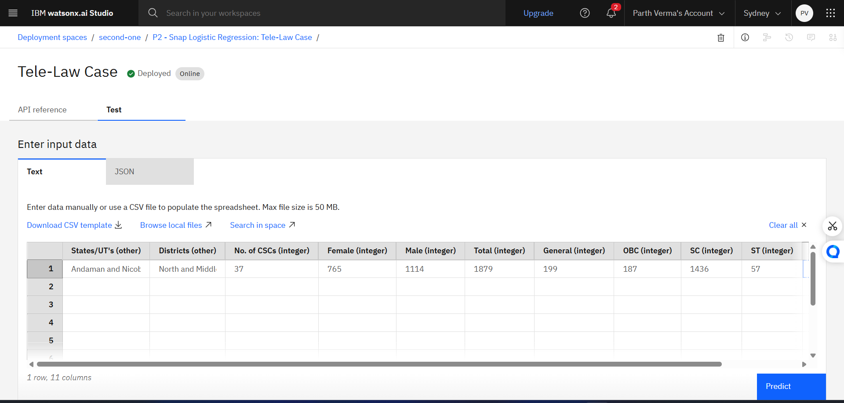
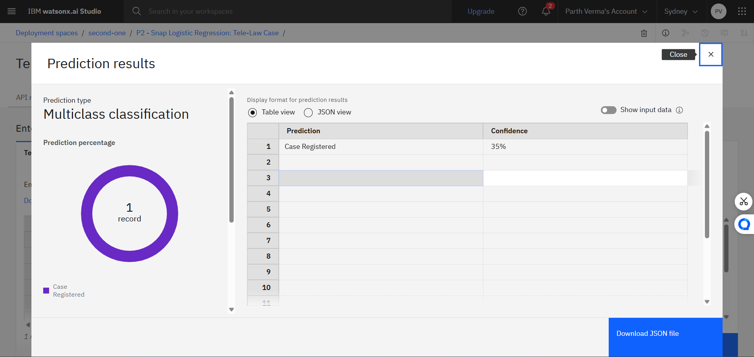
Result
The system identifies gender and caste-based utilization gaps and highlights districts with low Tele-Law outreach. CSC-adjusted comparisons provide a clear view of regional disparities. Visual outputs such as charts and heatmaps support effective interpretation of results.

Slide 8
Conclusion
The analysis provides meaningful insights into inclusivity and accessibility of Tele-Law services. It supports evidence-based policymaking and helps optimize legal aid outreach to underserved communities and regions.

Slide 9
Future scope
The system can be enhanced by integrating real-time data, predictive analytics for outreach planning, and GIS-based visualization. Future work may also include analysis of case outcomes and user satisfaction.

Slide 10
References
District-wise Tele-Law Case Registration Data (FY 2021–22 to 2024–25)
Source: data.gov.in
IBM Cloud & Watson Studio Documentation

Slide 11
GITHUB LINK
GitHub Link:- https://github.com/parthverma9805/Tele-Law-Case-Registrations

Slide 12
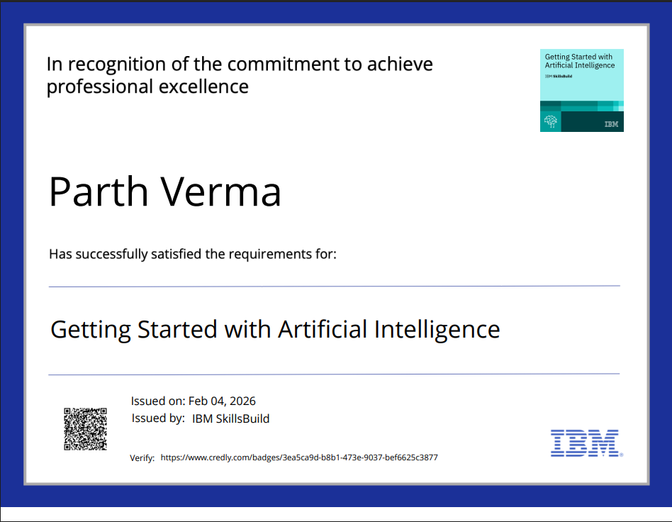
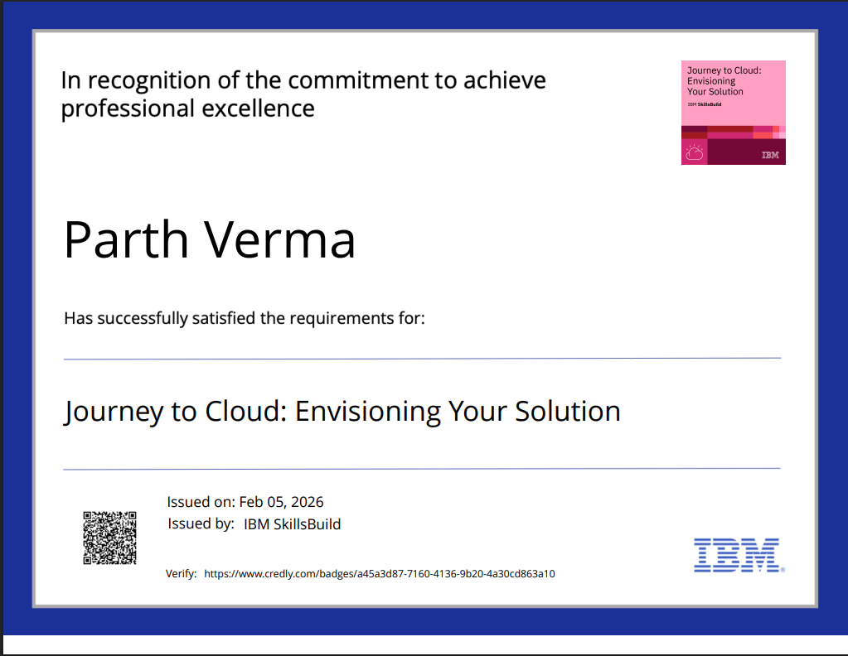
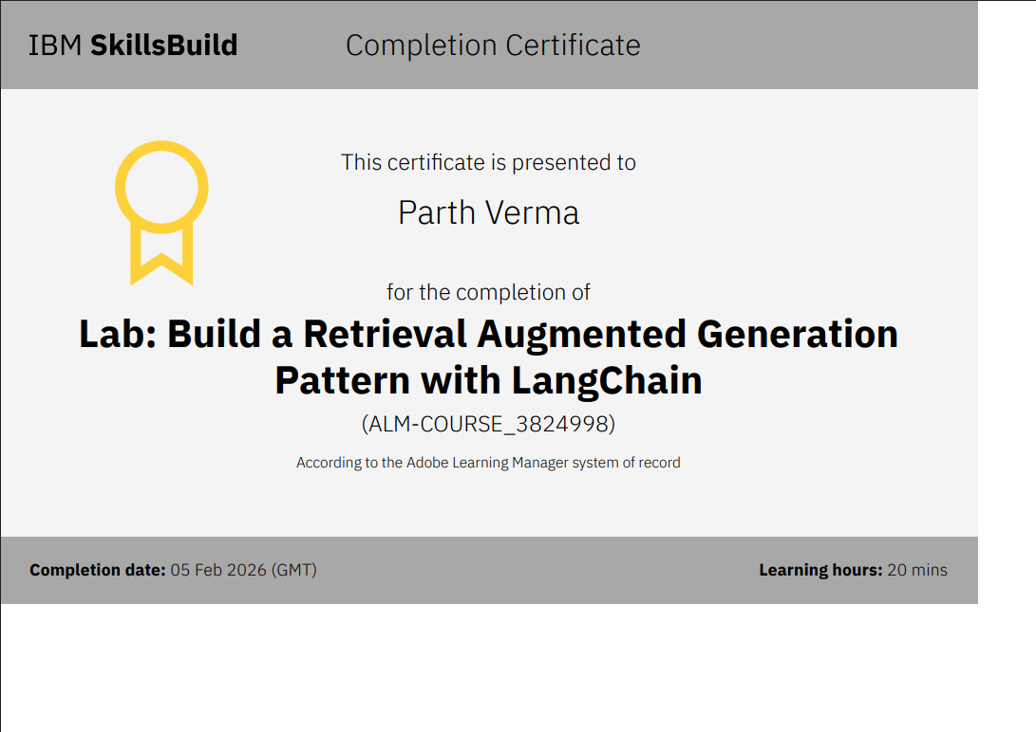
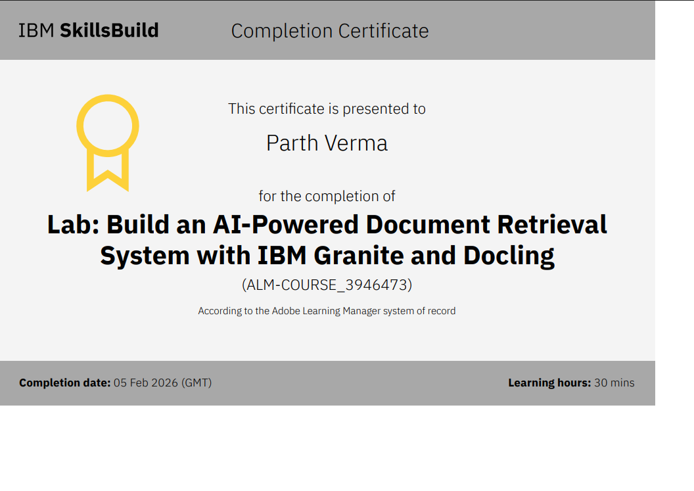
CERTIFICATES

Slide 13
THANK YOU

